Slide 1

The Hotel Name
123 Address St
Anytown, ST 12345
Reception immediately following the ceremony
Saturday, September 4, 20XX at 3pm

Slide 2
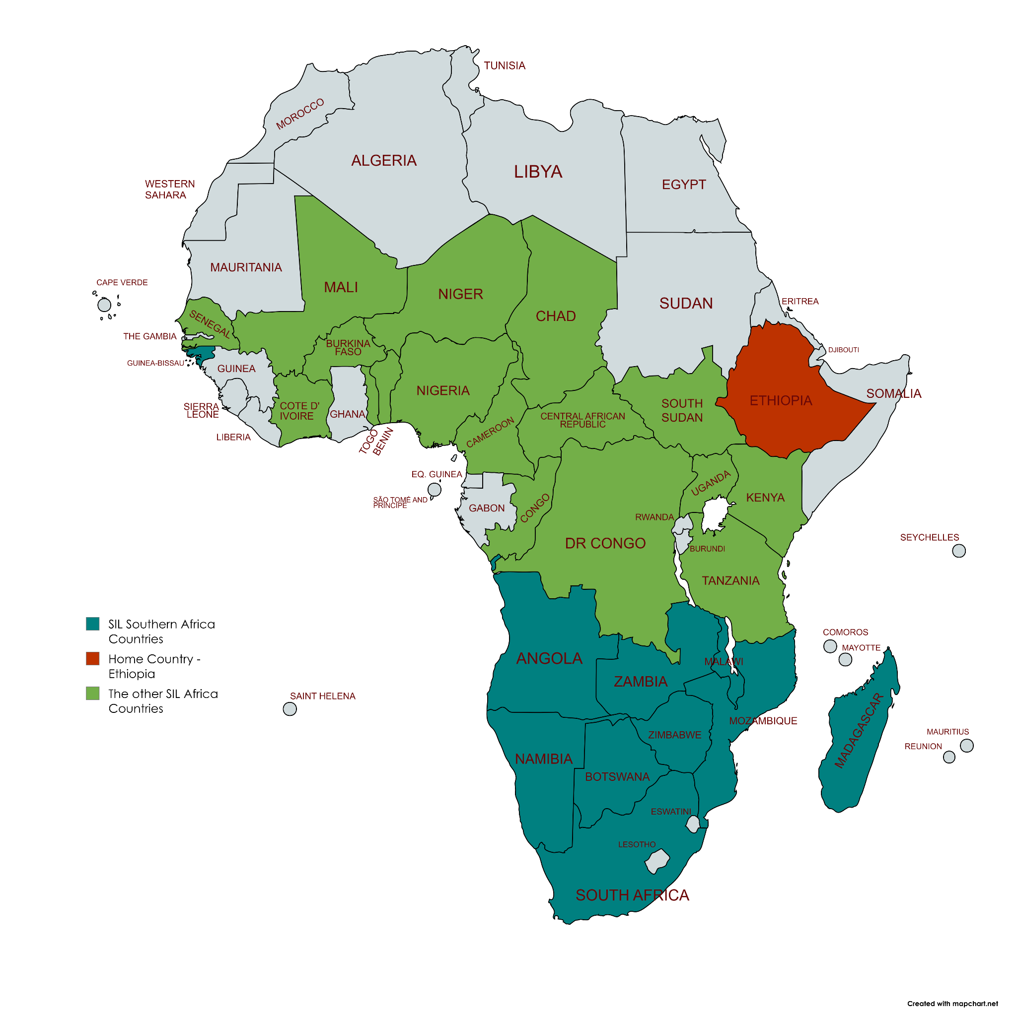

Slide 3
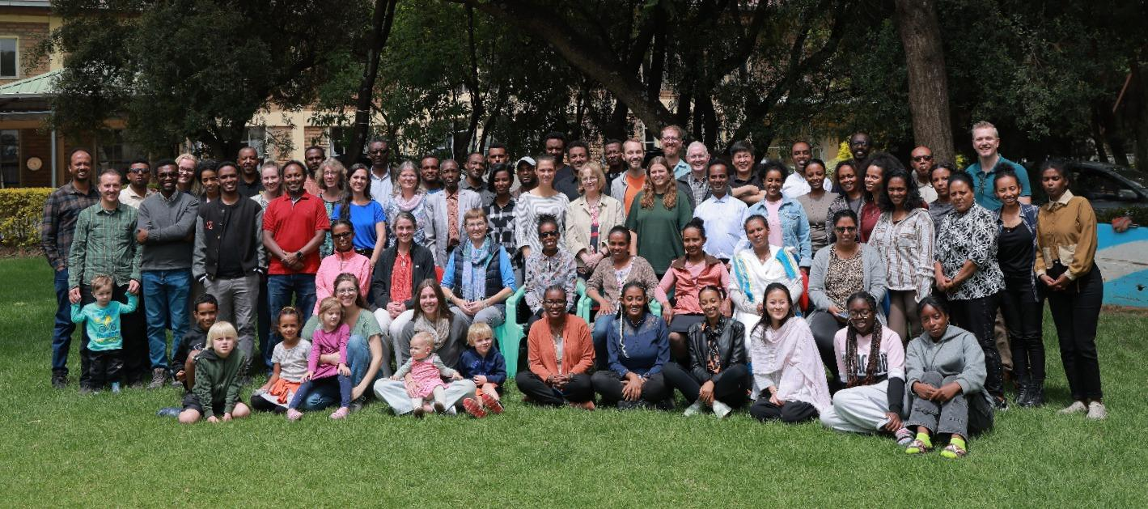

Slide 4


Slide 5


Slide 6
The Hotel Name
123 Address St
Anytown, ST 12345
Reception immediately following the ceremony
Saturday, September 4, 20XX at 3pm

Slide 7
John 12:23-26
How shall we die for Christ?

Slide 8
John 12:23-26
Jesus replied, “The hour has come for the Son of Man to be glorified. Very truly I tell you, unless a kernel of wheat falls to the ground and dies, it remains only a single seed. But if it dies, it produces many seeds. Anyone who loves their life will lose it, while anyone who hates their life in this world will keep it for eternal life. Whoever serves me must follow me; and where I am, my servant also will be. My Father will honor the one who serves me.

Slide 9
Context
John 12:12-19 - Triumphant Entry
John 12:20-22 - Greeks want to meet him
John 12:23-26 - Jesus’ example of dying
John 12:27-36 - Jesus explains the kind of Messiah he is

Slide 10
John 12:23-26
Jesus replied, “The hour has come for the Son of Man to be glorified. Very truly I tell you, unless a kernel of wheat falls to the ground and dies, it remains only a single seed. But if it dies, it produces many seeds. Anyone who loves their life will lose it, while anyone who hates their life in this world will keep it for eternal life. Whoever serves me must follow me; and where I am, my servant also will be. My Father will honor the one who serves me.

Slide 11
Wheat Multiplication
Agricultural economy - normal concept
1 seed x 1 stalk x 1 head x 30 grains = 30 grains
1 seed x 7 stalks x 1 head x 50 grains = 350 grains
By dying, what are we to multiply?

Slide 12
Types of Multiplication
Christ’s death → Leads to salvation of the world
Christ’s follower’s death → Leads to global evangelism
Personal Internal Dying → Leads to external fruit

Slide 13
Personal Spiritual Multiplication: Internal dying leads to external fruit

Slide 14
“Fruitfulness comes only through dying. The mystery of the grain teaches us the way of downward mobility, surrender, and trust.”
Henri Nouwen

Slide 15
Personal Spiritual Multiplication: Internal dying leads to external fruit
Die to Self Ambition
“Seek first the kingdom of God and his righteousness…”
(Matthew 6:33)

Slide 16
Personal Spiritual Multiplication: Internal dying leads to external fruit
Die to Self Ambition
Die to Pride
“Whoever wants to become great among you must be your servant…”
(Mark 10:43–45)

Slide 17
Personal Spiritual Multiplication: Internal dying leads to external fruit
Die to Self Ambition
Die to Pride
Die to People Pleasing
“If I were still trying to please people, I would not be a servant of Christ.”
(Galatians 1:10)

Slide 18
Personal Spiritual Multiplication: Internal dying leads to external fruit
Die to Self Ambition
Die to Pride
Die to People Pleasing
Die to Earthly Comfort
“Whoever wants to be my disciple must deny themselves and take up their cross daily…”
(Luke 9:23)

Slide 19
Personal Spiritual Multiplication: Internal dying leads to external fruit
Die to Self Ambition
Die to Pride
Die to People Pleasing
Die to Earthly Comfort
Die to Materialism
“Do not store up for yourselves treasures on earth…” (Matthew 6:19–21)

Slide 20
Personal Spiritual Multiplication: Internal dying leads to external fruit
Die to Self Ambition
Die to Pride
Die to People Pleasing
Die to Earthly Comfort
Die to Materialism
Die to Bitterness
“Forgive as the Lord forgave you.”
(Colossians 3:13)

Slide 21
Personal Spiritual Multiplication: Internal dying leads to external fruit
Die to Self Ambition
Die to Pride
Die to People Pleasing
Die to Earthly Comfort
Die to Materialism
Die to Bitterness
Die to Fear
“For God has not given us a spirit of fear, but of power, love, and a sound mind.”
(2 Timothy 1:7–8)

Slide 22
Personal Spiritual Multiplication: Internal dying leads to external fruit
Die to Self Ambition
Die to Pride
Die to People Pleasing
Die to Earthly Comfort
Die to Materialism
Die to Bitterness
Die to Fear
Die to …

Slide 23
Personal Spiritual Multiplication: Internal dying leads to external fruit
Die to Self Ambition
Die to Pride
Die to People Pleasing
Die to Earthly Comfort
Die to Materialism
Die to Bitterness
Die to Fear
Die to …….

Slide 24
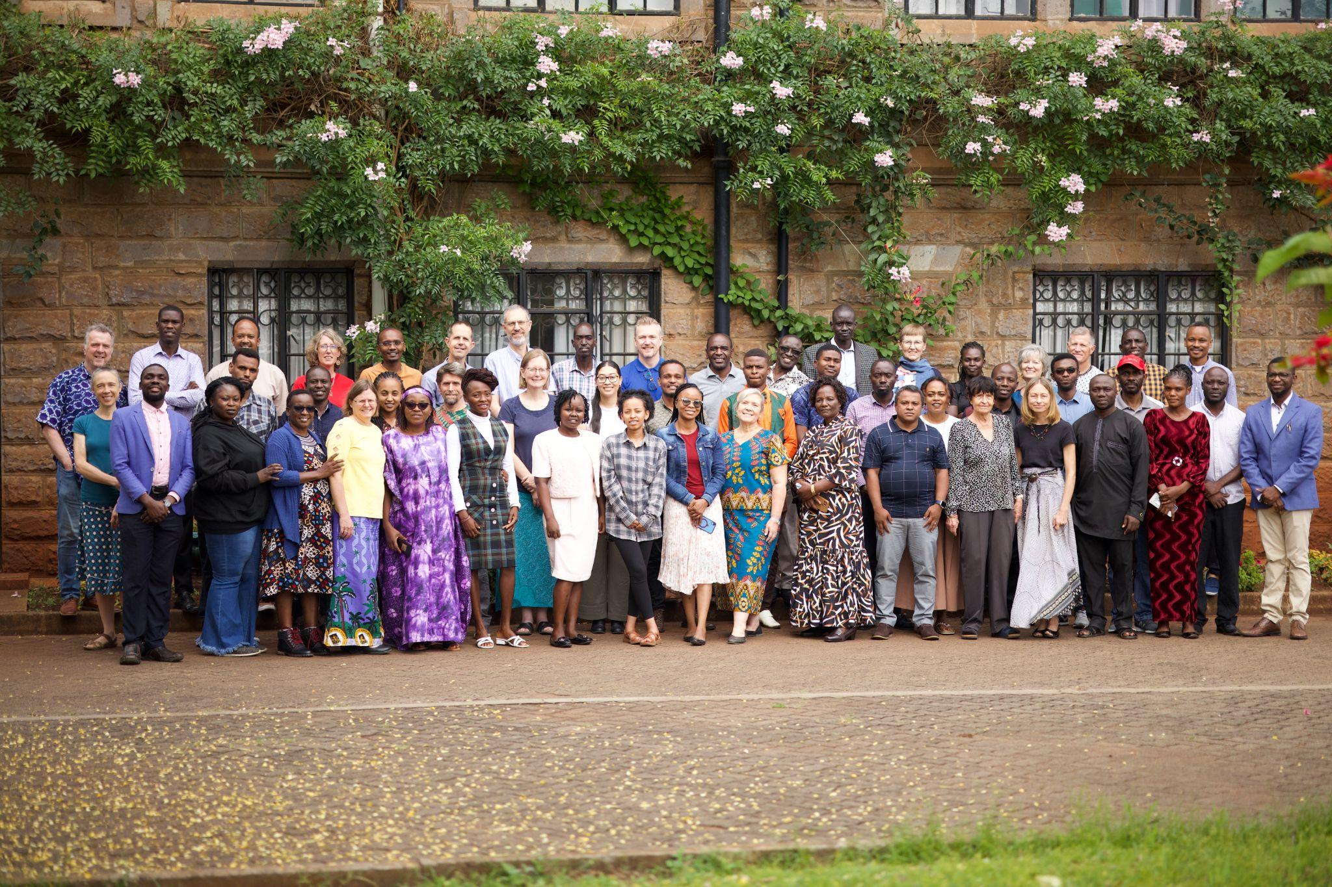
The Hotel Name
123 Address St
Anytown, ST 12345
Reception immediately following the ceremony
Saturday, September 4, 20XX at 3pm

Slide 25
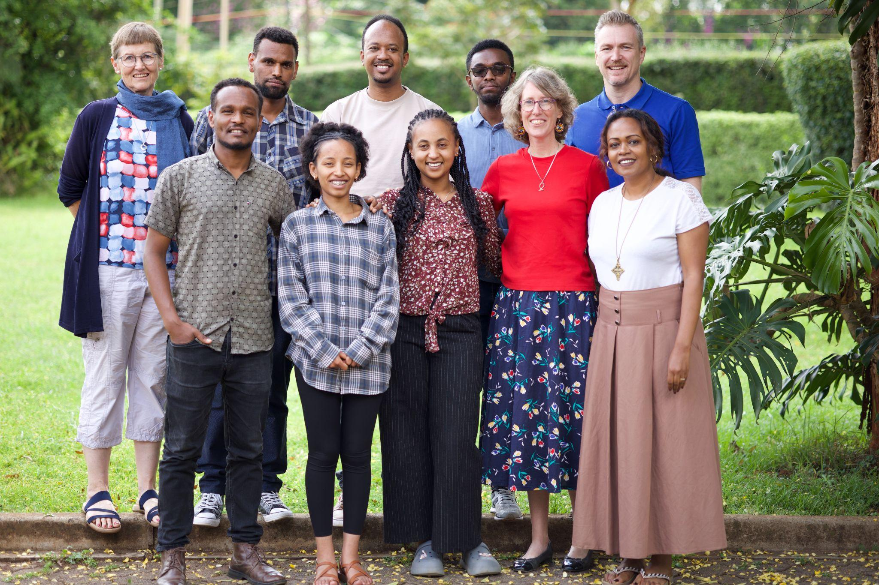
The Hotel Name
123 Address St
Anytown, ST 12345
Reception immediately following the ceremony
Saturday, September 4, 20XX at 3pm

Slide 26
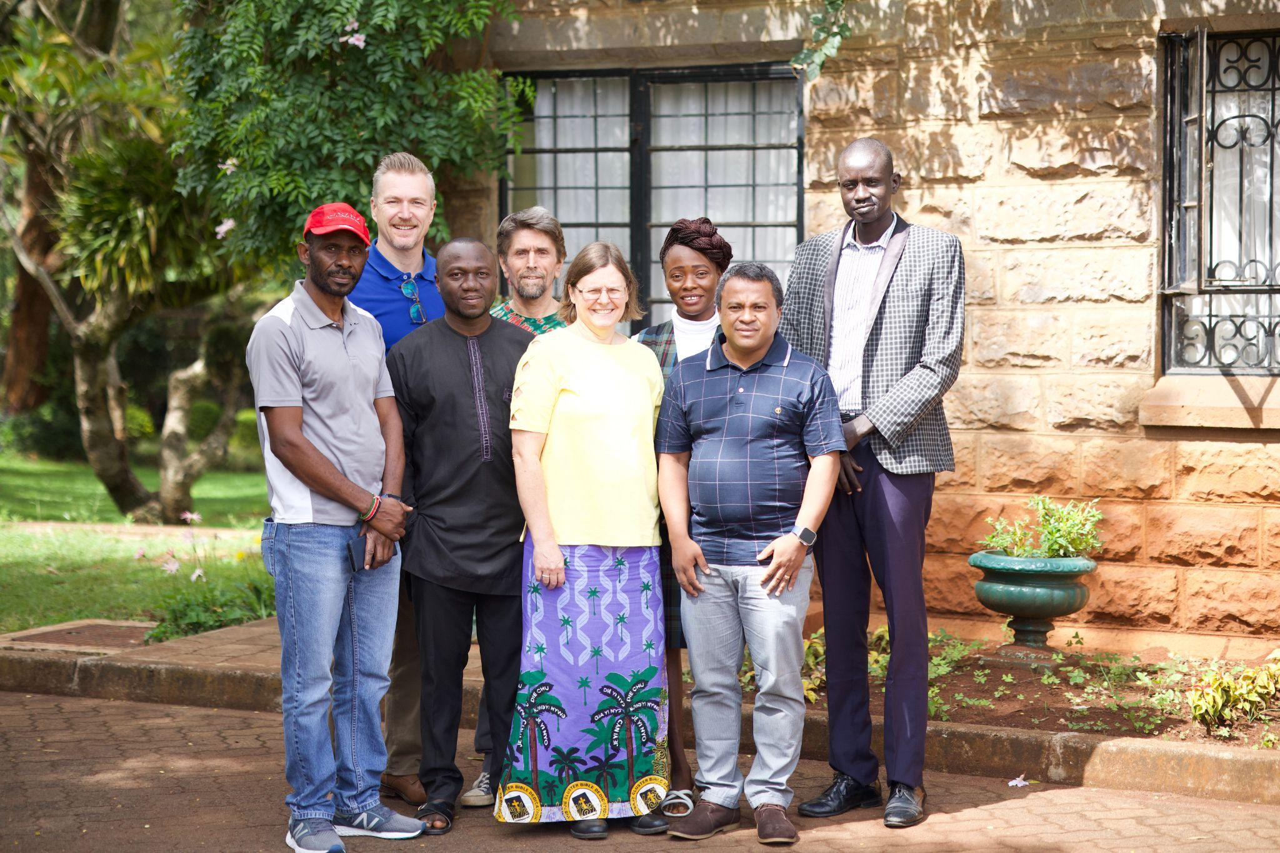
The Hotel Name
123 Address St
Anytown, ST 12345
Reception immediately following the ceremony
Saturday, September 4, 20XX at 3pm

Slide 27
John 12:23-26
Jesus replied, “The hour has come for the Son of Man to be glorified. Very truly I tell you, unless a kernel of wheat falls to the ground and dies, it remains only a single seed. But if it dies, it produces many seeds. Anyone who loves their life will lose it, while anyone who hates their life in this world will keep it for eternal life. Whoever serves me must follow me; and where I am, my servant also will be. My Father will honor the one who serves me.

Slide 28
John 12:23-26
How shall we die for Christ?

